Slide 1



Personal motives behind minimalism and veganism
Wasseem Salami & Nelly Groissman
Notes:
What is our research question

Slide 2


Tagged Data
veganism |  | minimalism
labeled | prediction | labeled | prediction
11 | 11 | 9 | 11 | biospheric
13 | 11 | 14 | 11 | egocentric
0 | 2 | 1 | 2 | mixed
Notes:
* In the previous Phases, we tagged 48 comments according to the motivations as we understood them. The results were quite similar in most cases, but there were also some that were not.
* How did the classification work? Employees were asked to rate two questions for each motivation on a scale of 1-5.
By comparing the averages of each pair of questions, the higher average was classified as the main motivation. Mixed motivation is one in which equal averages were received.
In the previous work, we conducted statistical analyses of the tagged comments both dichotomously and based on the continuous rating of each motivation.
However, this time, due to our small amount of data, we decided, after consulting with the Instructor, to perform the analyses categorically.

Slide 3
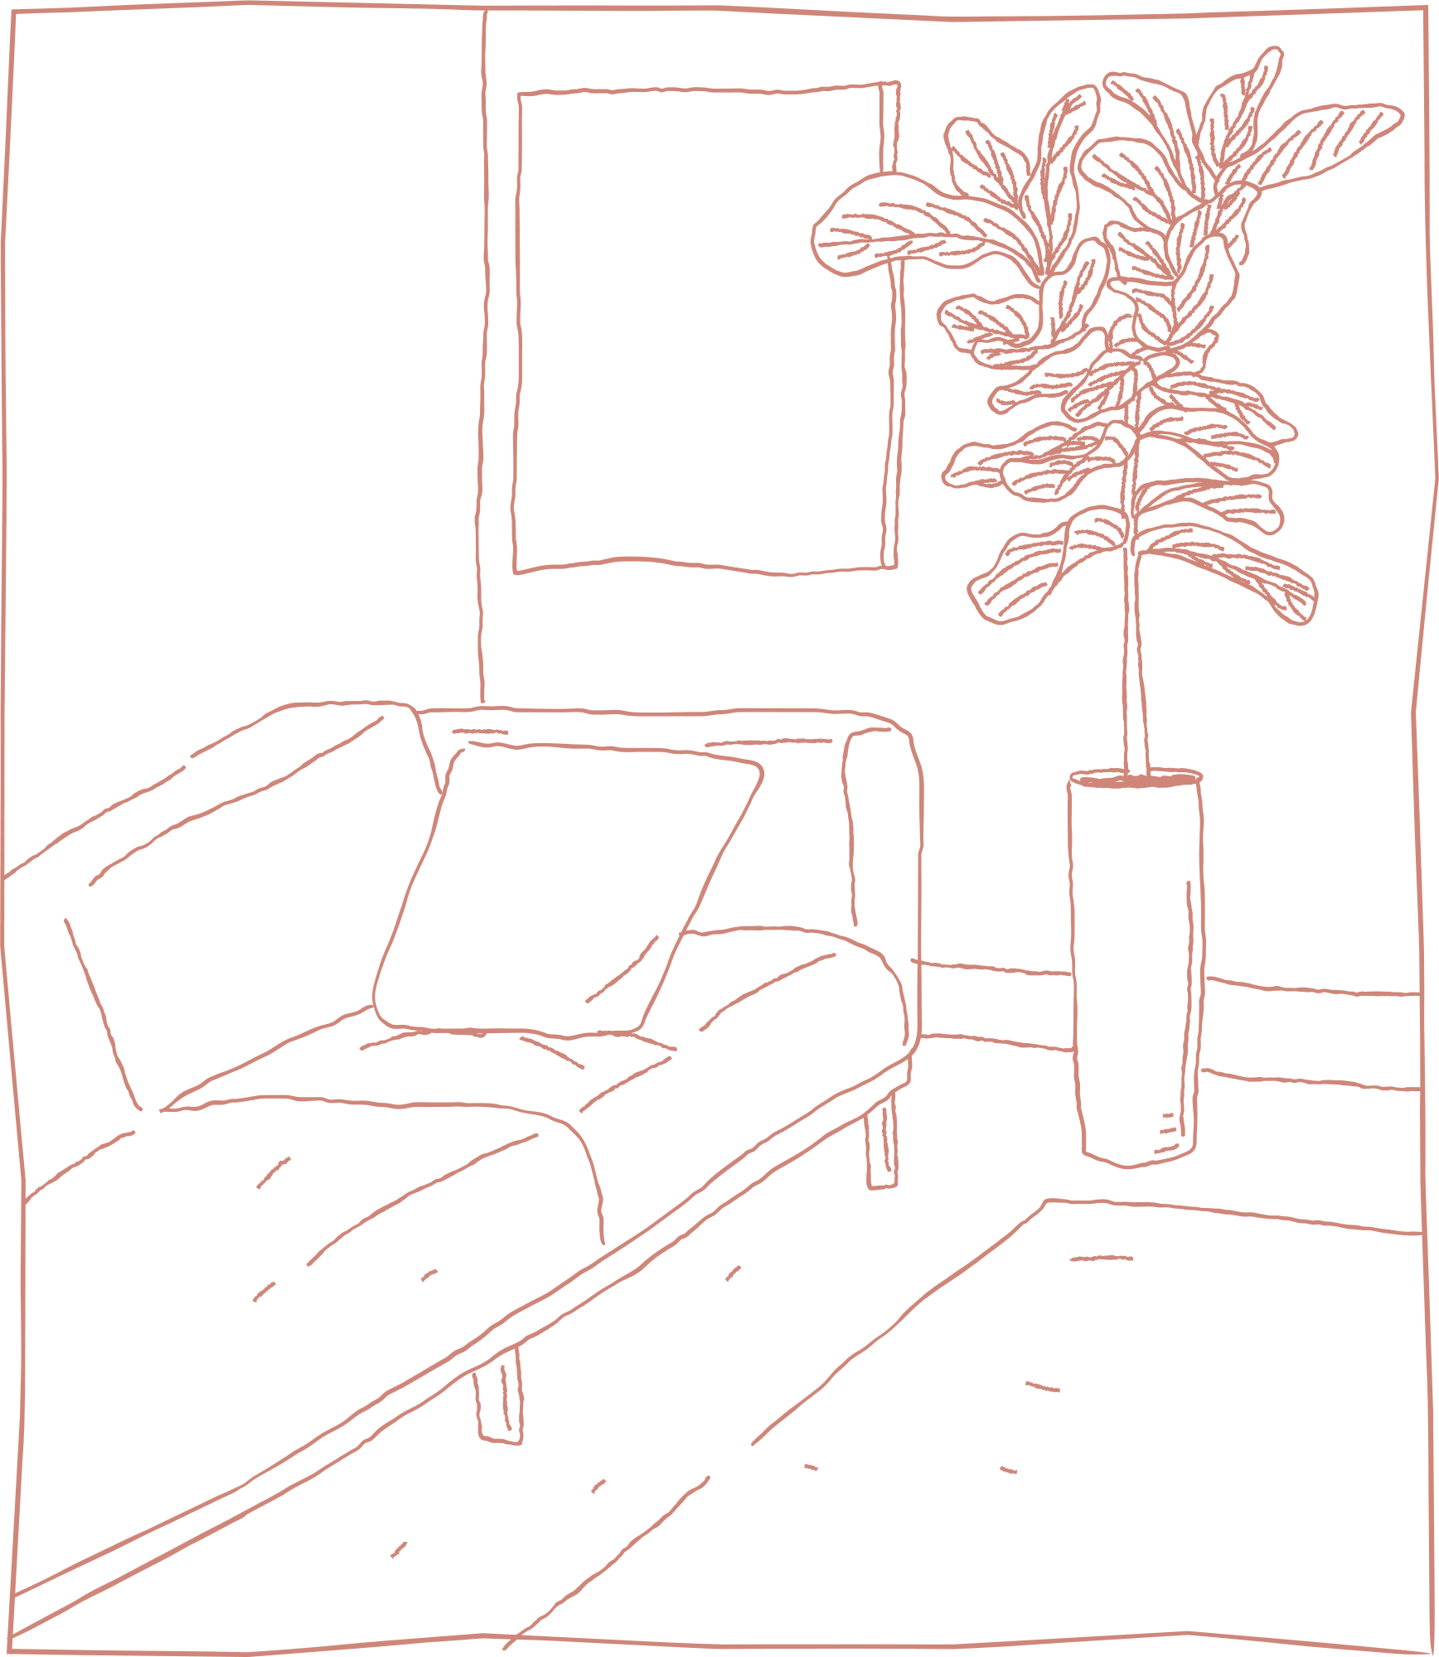
Choosing a Model
What is the
main motivation
In each behavior?
What is the
main motivation?
(N=48)
Minimalism
(N=24)
Veganism
(N=24)
Biospheric
or
Egocentric
Biospheric
or
Egocentric
Biospheric
or
Egocentric
Notes:
In the previous section, we referred to the amount of information – it was a significant challenge in the current exercise.
We debated on how to process the information: should we try to create a model that predicts motivation types beyond behavior?
Alternatively, should we create two models that predict motivations per behavior?
Why did we choose the second option? We observed in text analysis that there is almost no overlap in the common words between the two behaviors.

Slide 4
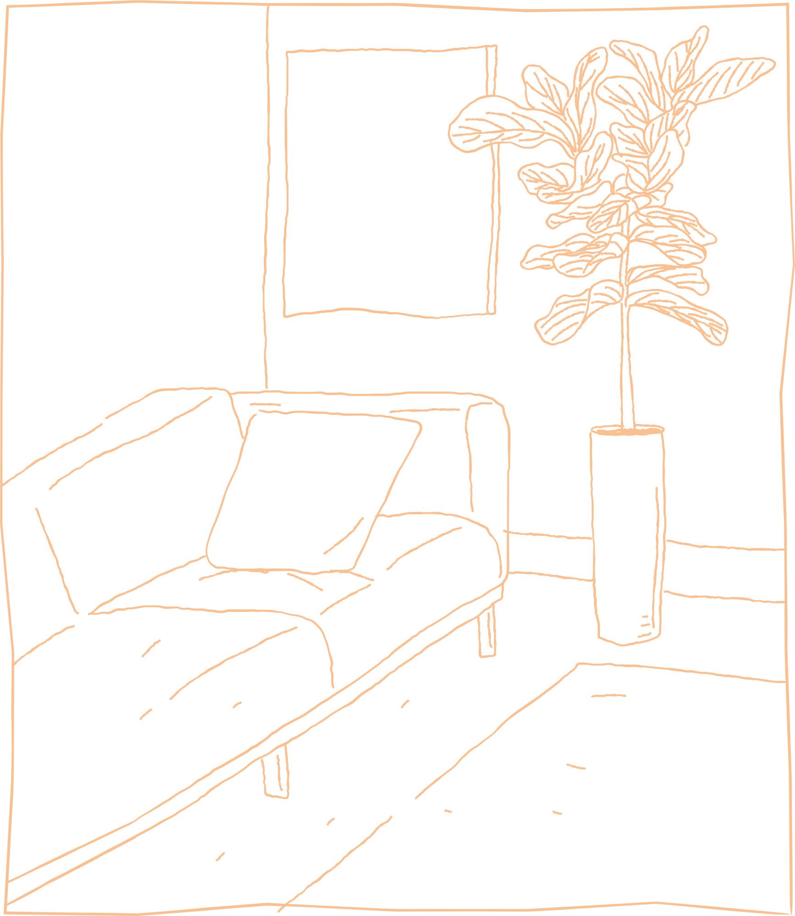
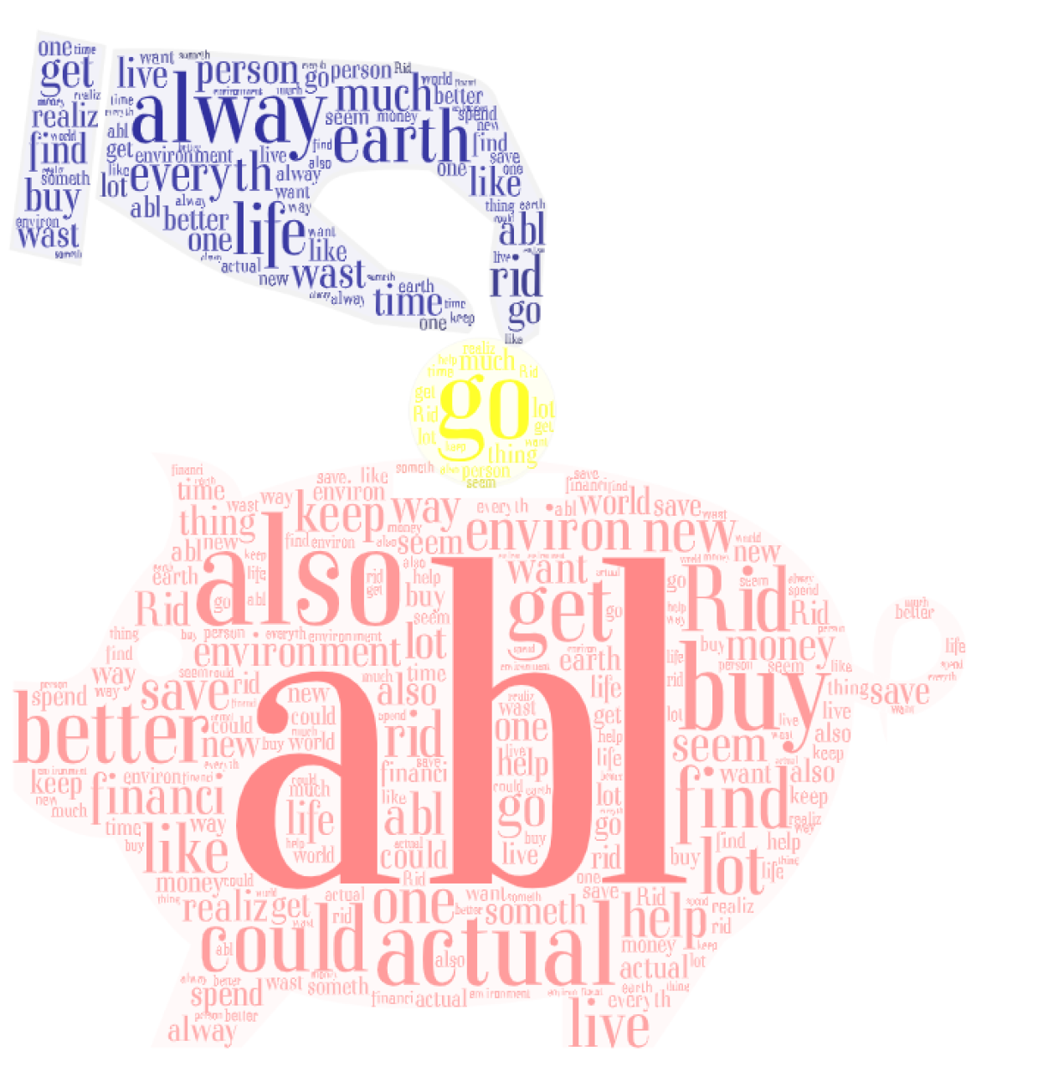

Feature Creation
Veganism
21 words
Minimalism
39 words
+ Compound
Notes:
In the feature analysis, what did we do? Which one did we choose? How?
Feature Creation: We identified 39 words in minimalism and 21 words in veganism that appear in 90% of the posts. Additionally, we added the compound score to each of these words.
Feature Selection: Various Featue Selection Methods resulting in choosing the Wrapper method for the Minimalism data Embedded Method for the Vegan data due to highest explainability.

Slide 5
Feature Selection
Minimalism
environment | compound | Wast(e) | earth | Alway(s)
 | + | + | + | + | Filter
+ | + | + | + |  | Wrapper
 | + |  |  |  | Embedded
Veganism
Motiv(ation) | want | compound | health | get | Anim(al) | Alway(s)
 |  |  | + | + | + | + | Filter
 |  | + |  | + | + | + | Wrapper
-0.17 | 0.27 | -0.19 |  |  | 1.61 |  | Embedded
Notes:
Embedded: Because our dataset is small from the start, we were very cautious about overfitting. On the right, you can see the analysis of linear regression on all labeled data – proving that we were heading in the right direction.
Minimalism Features:
Filter Features: ['always' 'earth' 'waste' 'compound']
Wrapper RFE Features: ['earth' 'environment' 'waste' 'compound']
Embedded Features: ['compound’]
Vegan Features:
Filter Features: ['always' 'animal' 'get' 'health']
Wrapper RFE Features: ['earth' 'environment' 'waste' 'compound']
Embedded Features: ['animal' 'motivation' 'want' 'compound']

Slide 6
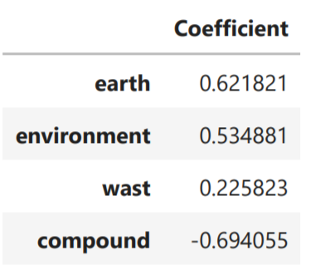
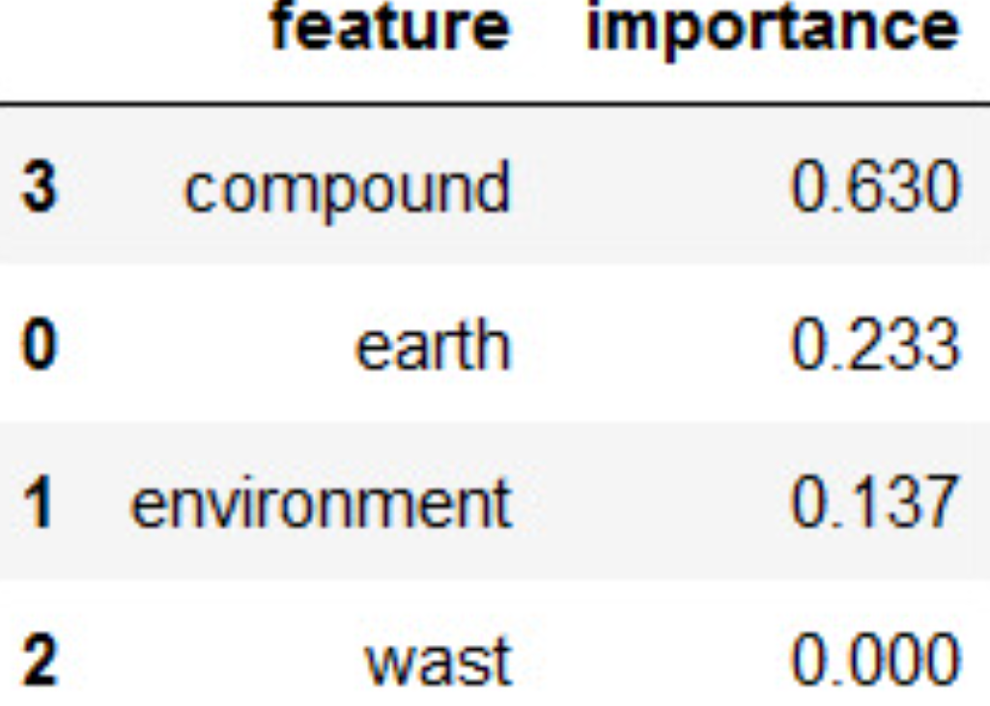
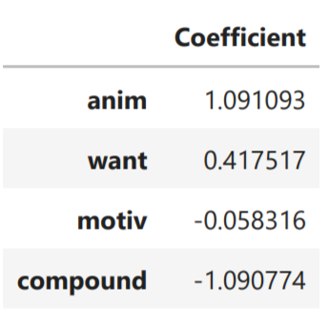
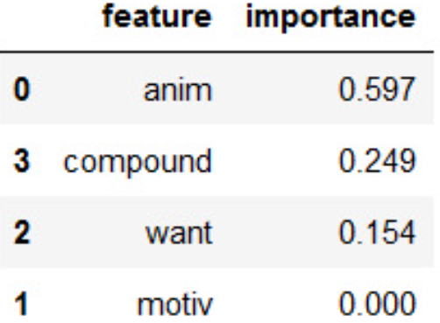
selected features’ Decisiveness in informative models
Fitted on the whole labeled set
Linear regression
Decision tree
Minimalism
Veganism

Slide 7

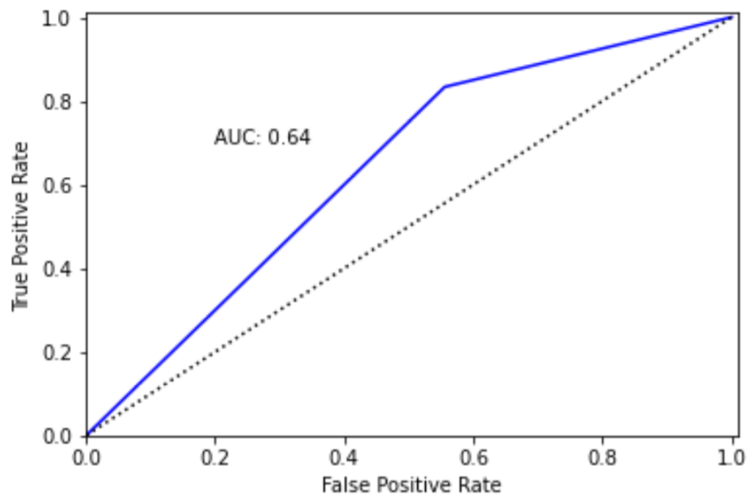
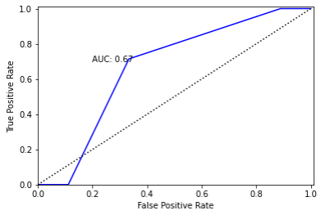

Model Selection : evaluation on Train Set
With LOO Cross Validation
1. Nearest Neighbors
Minimalism:
Veganism:

Slide 8
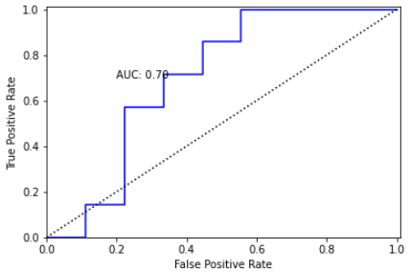
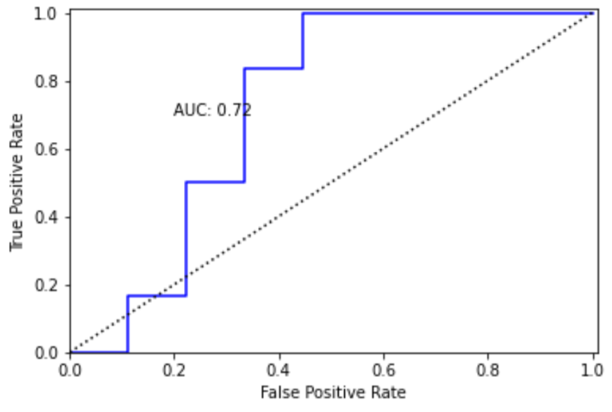
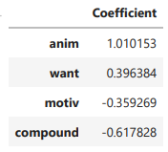
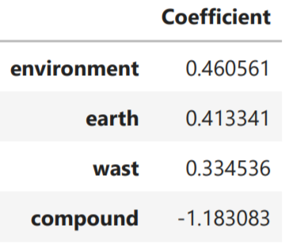
2. Logistic Regression
Veganism:
Minimalism:

Slide 9
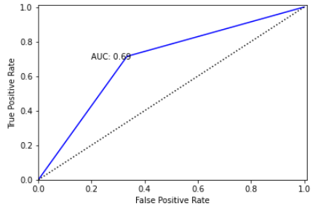
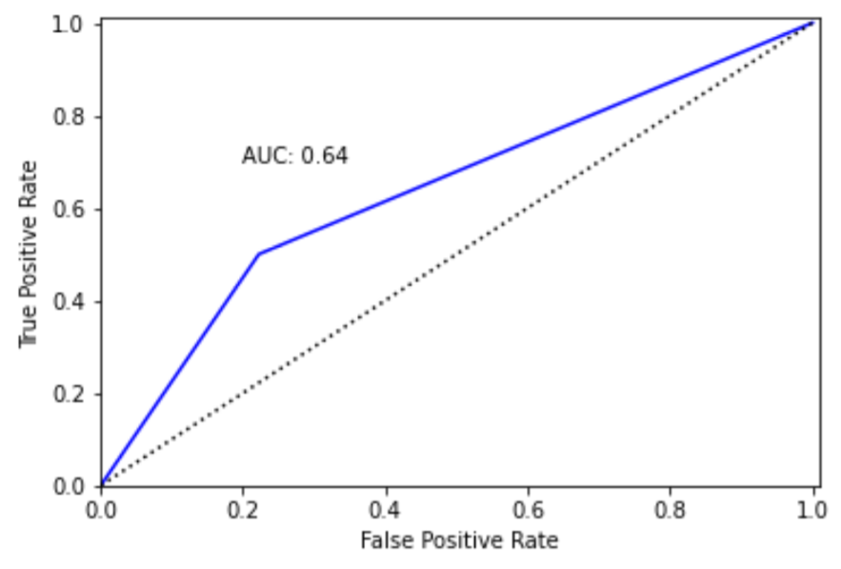
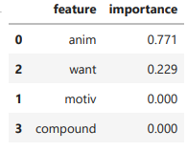
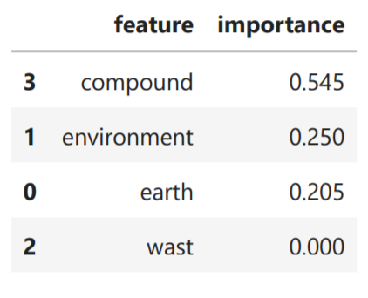
3. Decision Tree
Veganism:
Minimalism:

Slide 10
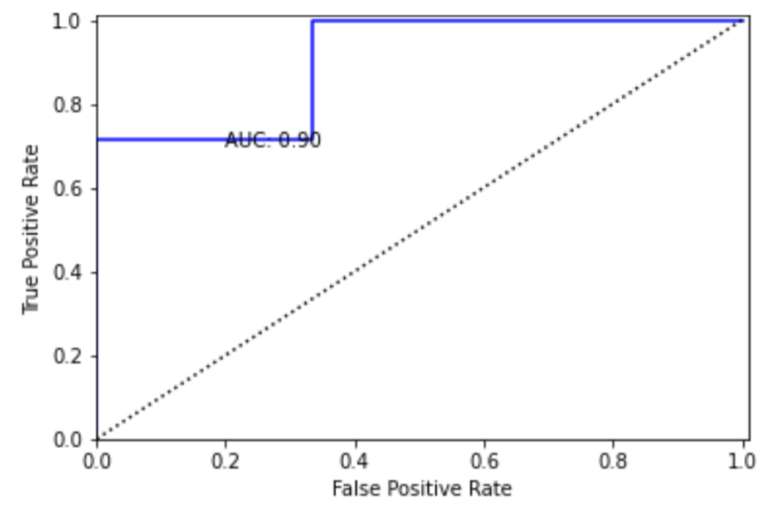
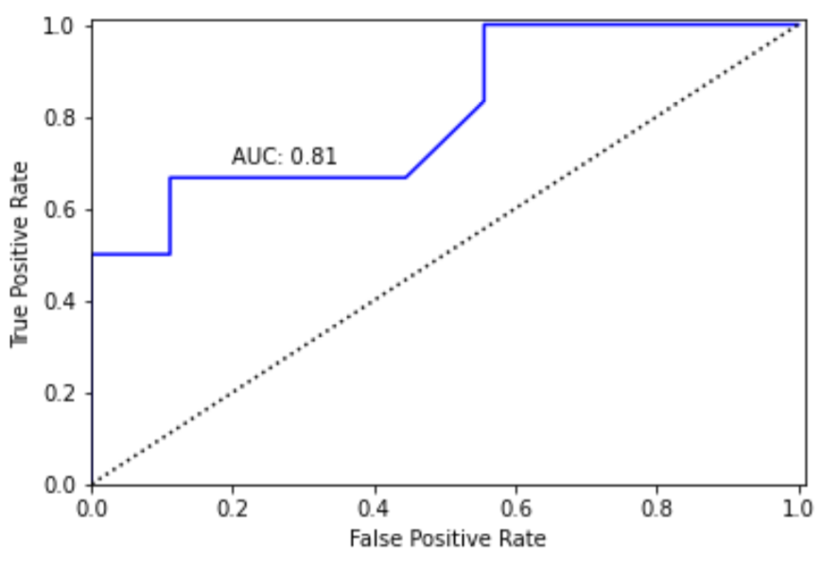

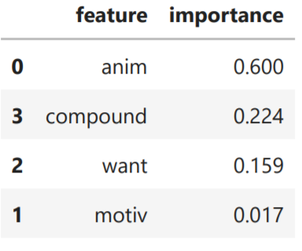
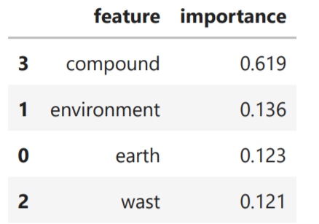
4.Winner :Random Forest - LOO evaluation on Train Set
Veganism:
Minimalism:
Notes:
(Supervised On the TRAIN subset of the labled data)

Slide 11
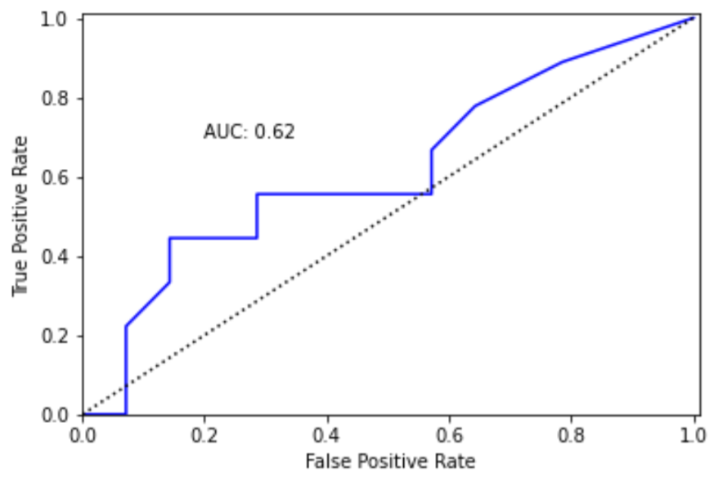
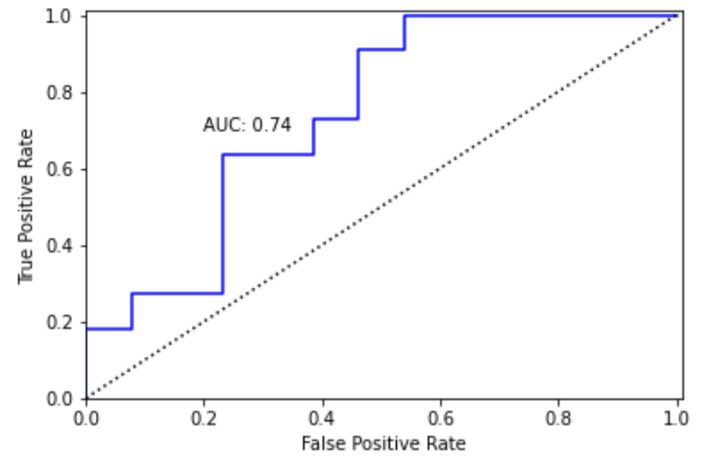


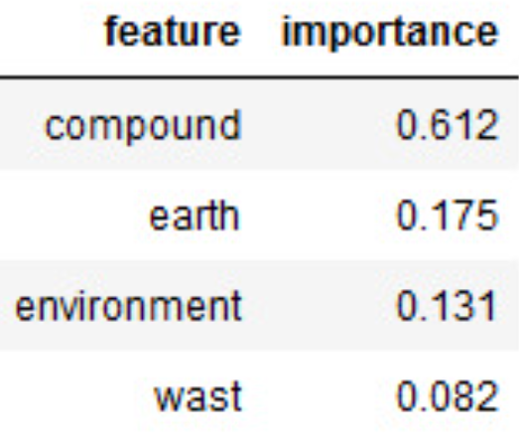
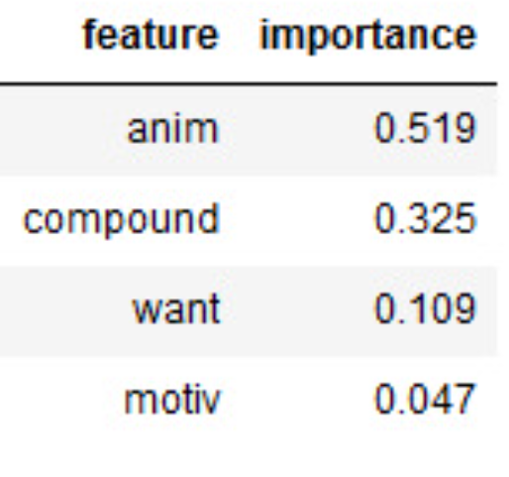

LOO CV with Random Forest on the whole labeled sets
Minimalism:
Veganism:
Notes:
- we evaluated on the whole labled set with LOO due to our small labled set(24 for each behaviour)

Slide 12
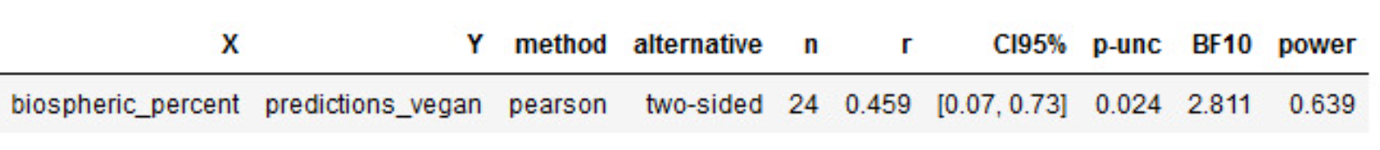
Correlation Test
On labeled data
Veganism:
Minimalism:
Notes:
We examined correlations between the scores obtained in the model and the scores assigned by the Amazon MTurk workers.
It can be observed that in veganism, there is a distinct correlation of 0.46, meaning that as the post receives higher scores in biophilia from workers, the model also 'responds' accordingly.
In minimalism, the correlation is not distinct.

Slide 13


Prediction of motivation on Full Datasets
N=1244
N=403
Notes:
1244 comments in veganism, 403 in minimalism.

Slide 14
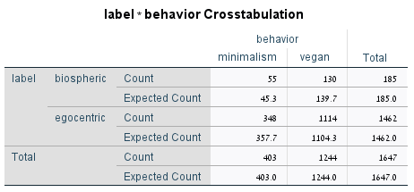
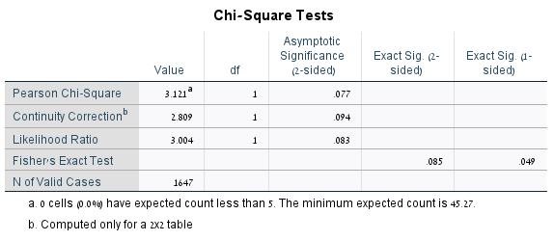
Chi Square test
N=1647
Notes:
There is no significant association between the type of behavior and type of motivation. in other words- type of motivation is independent from type of behavior

Slide 15
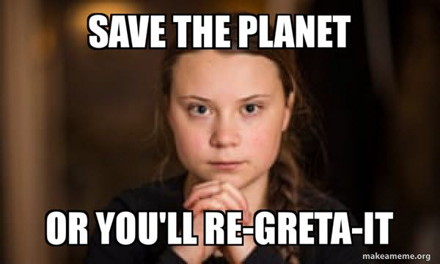
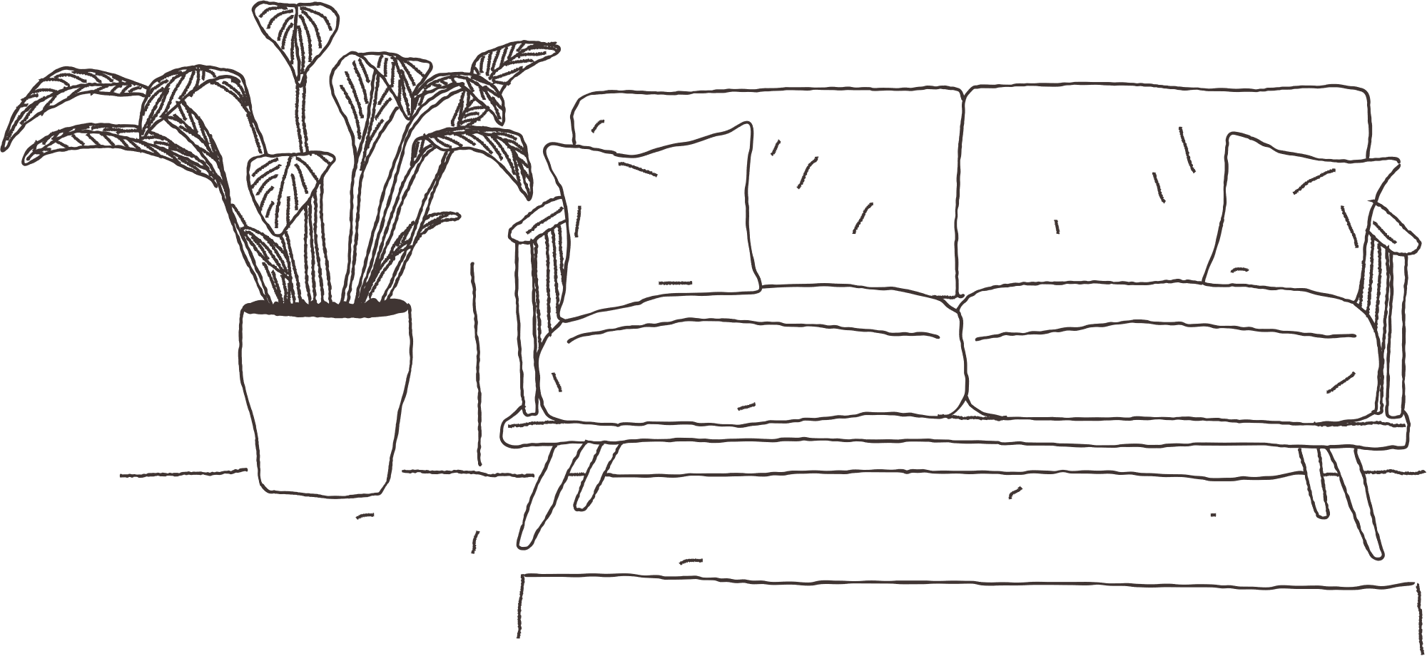
Thank you!

